Slide 1


Slide 2
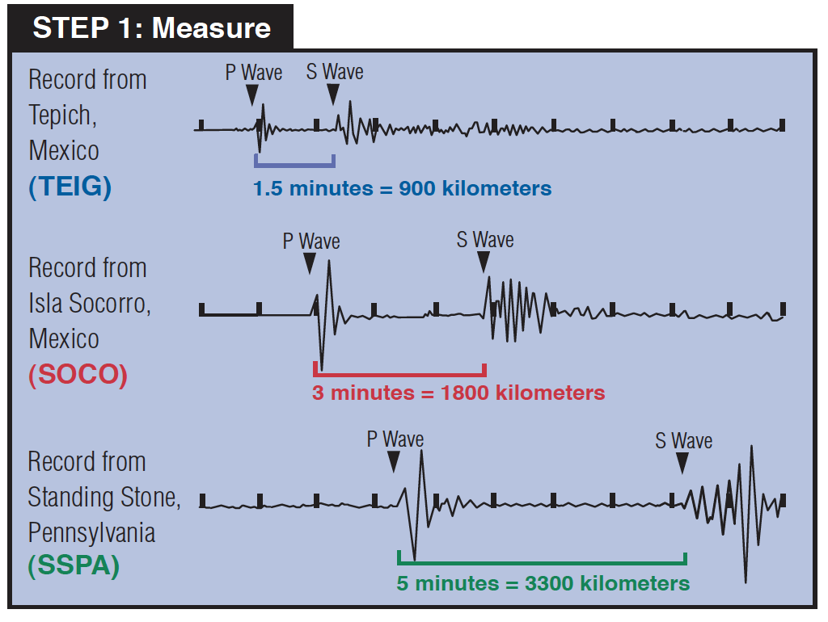
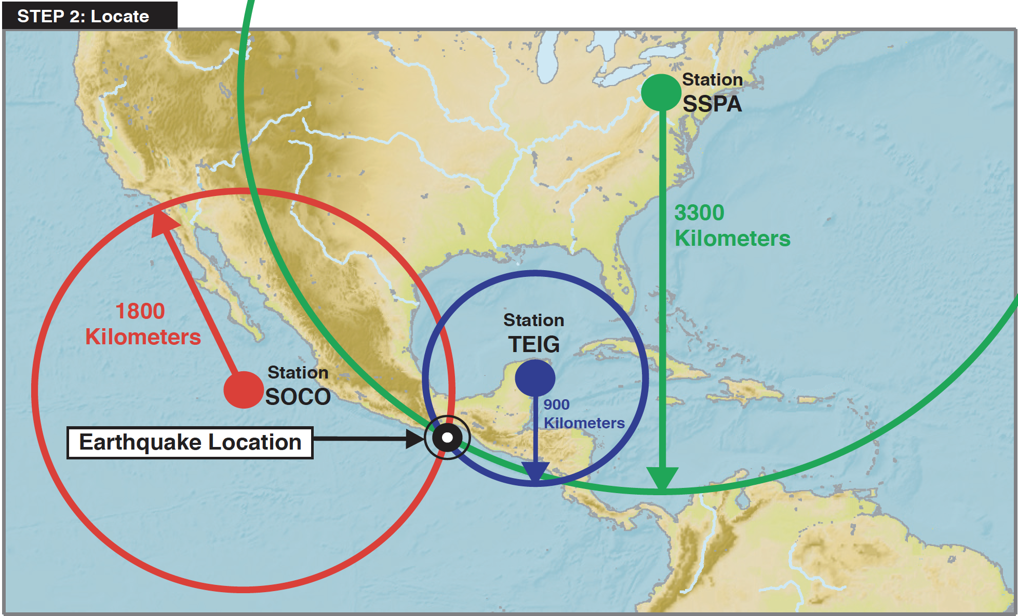

Slide 3
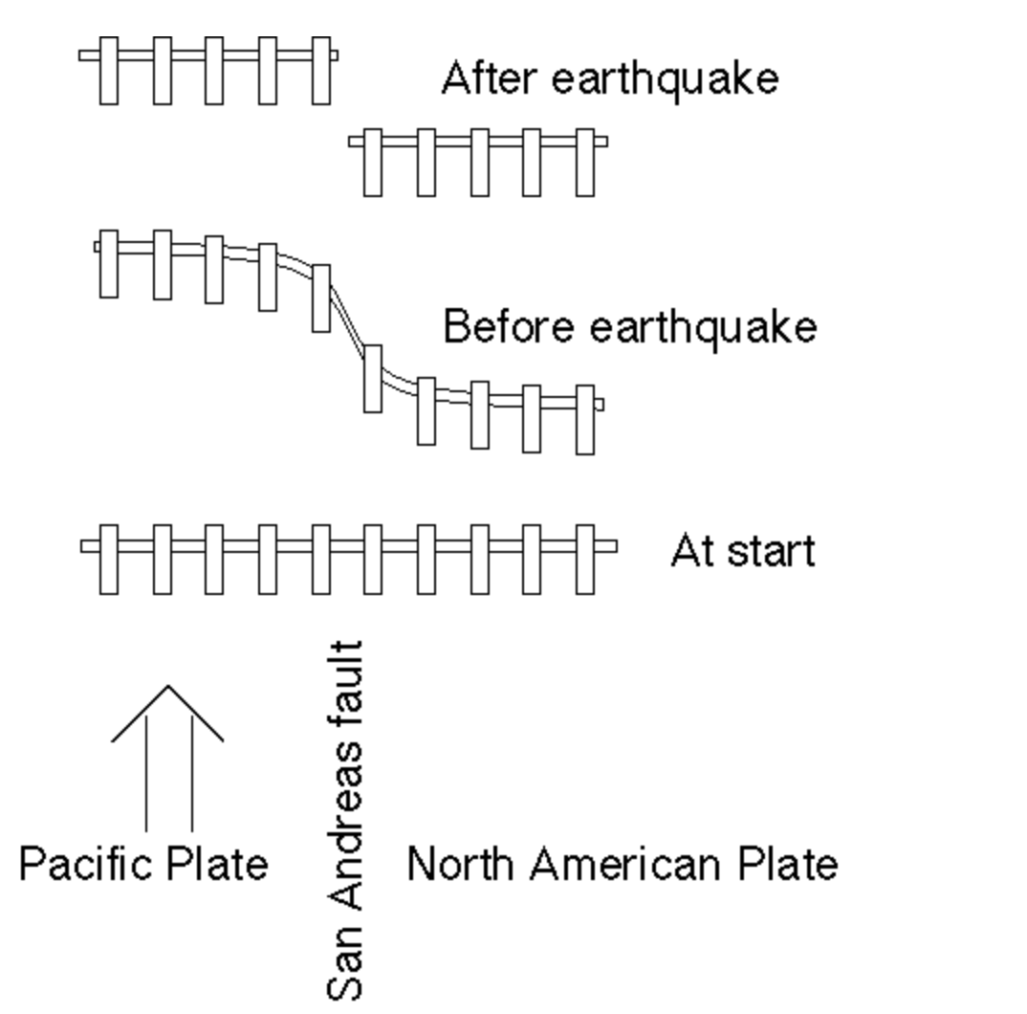
3] Once the frictional forces are exceeded, motion on the fault occurs i.e. an earthquake. The fence (and earth) returns to its original shape but in a new location.
2] The relative motion of the tectonic plates causes the fence (and earth) to bend and store elastic energy.
1] Original position of the fence (and earth), crossing the fault.

Slide 4
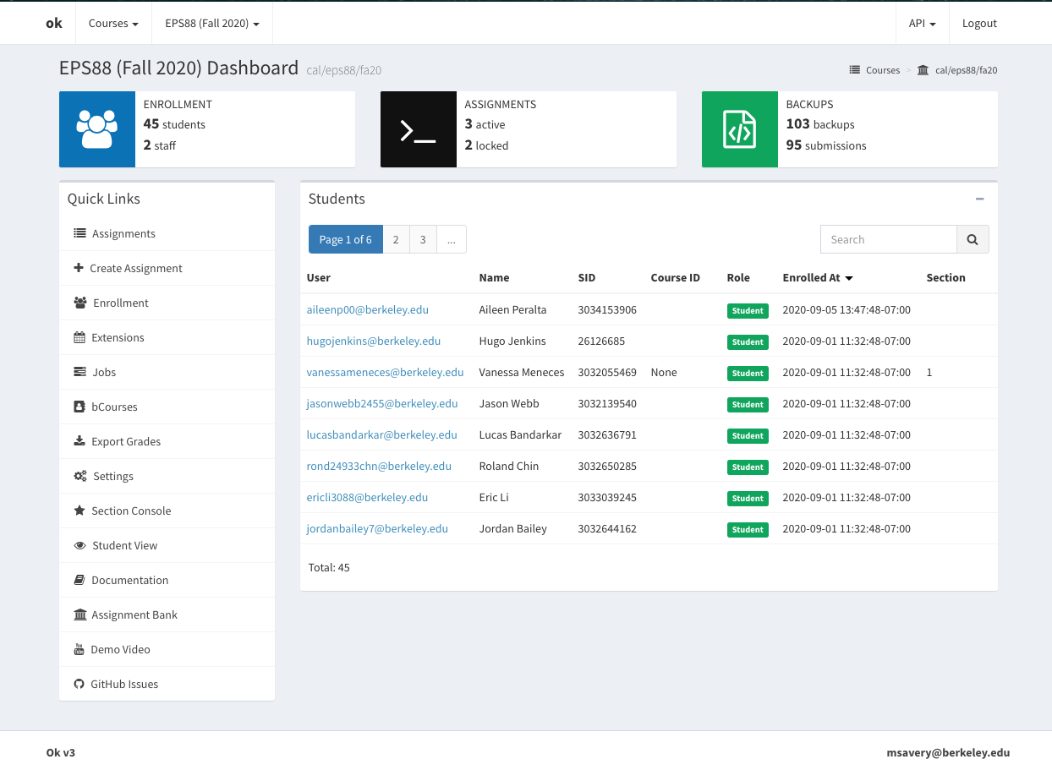

Slide 5
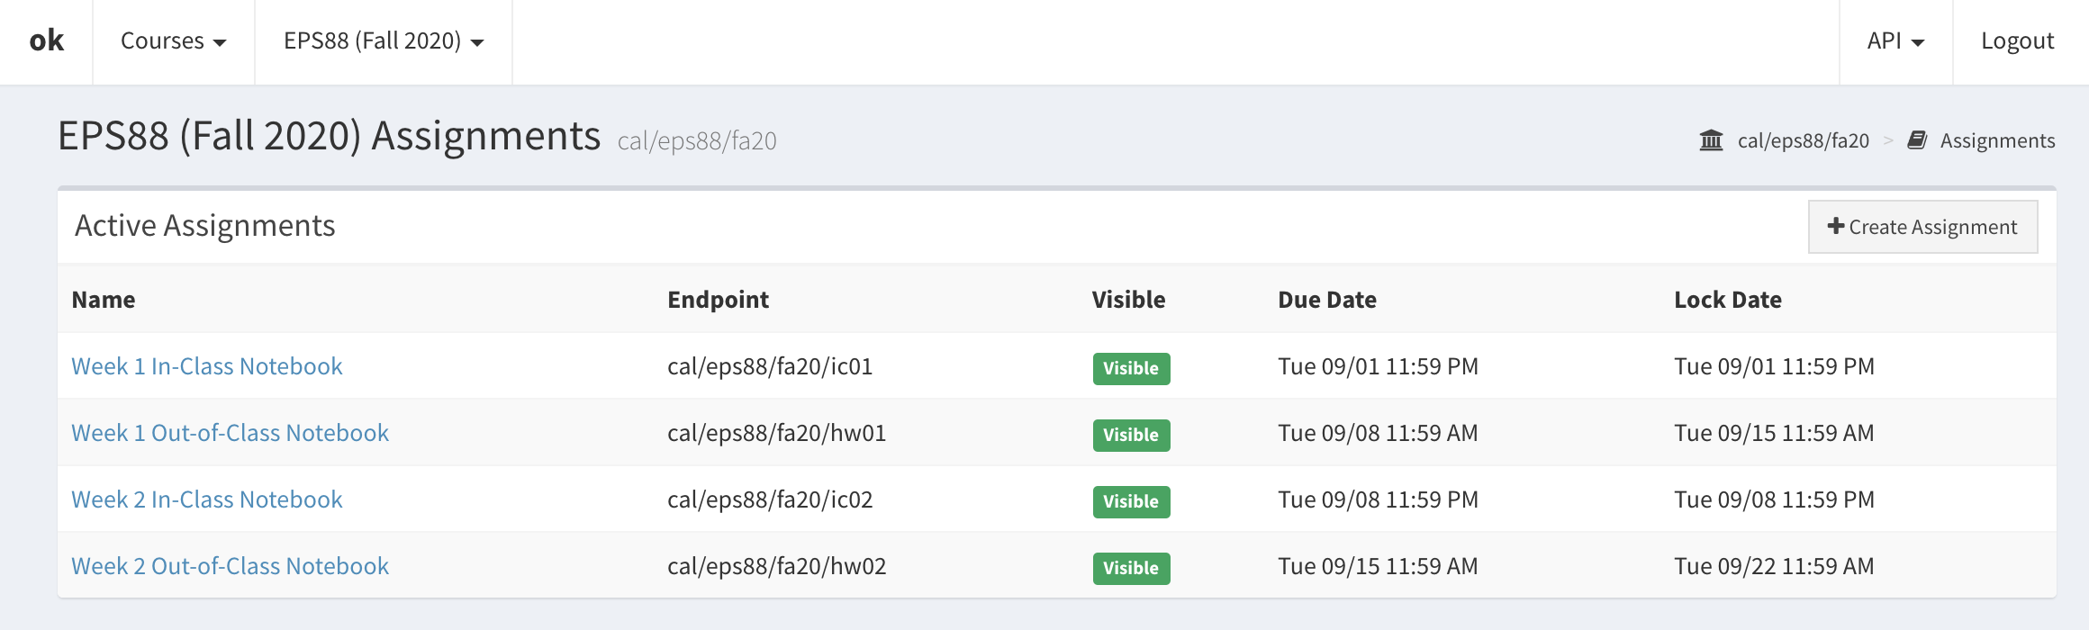

Slide 6
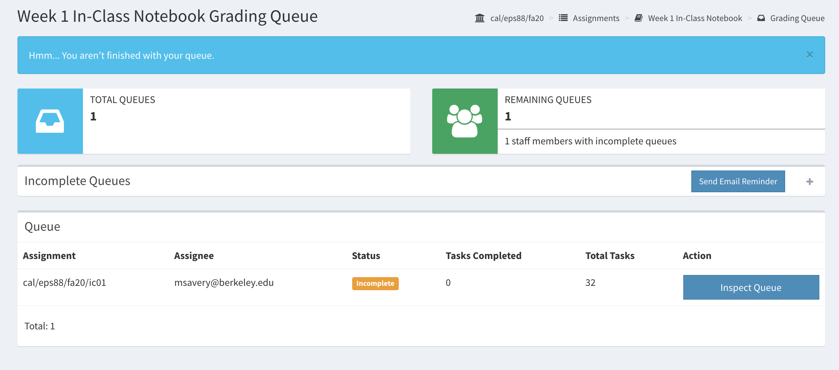

Slide 7
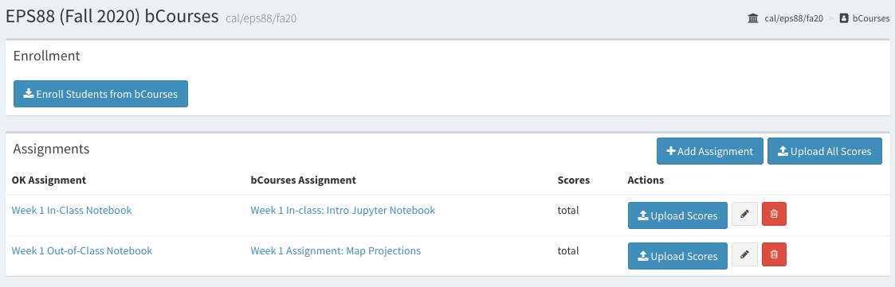

Slide 8
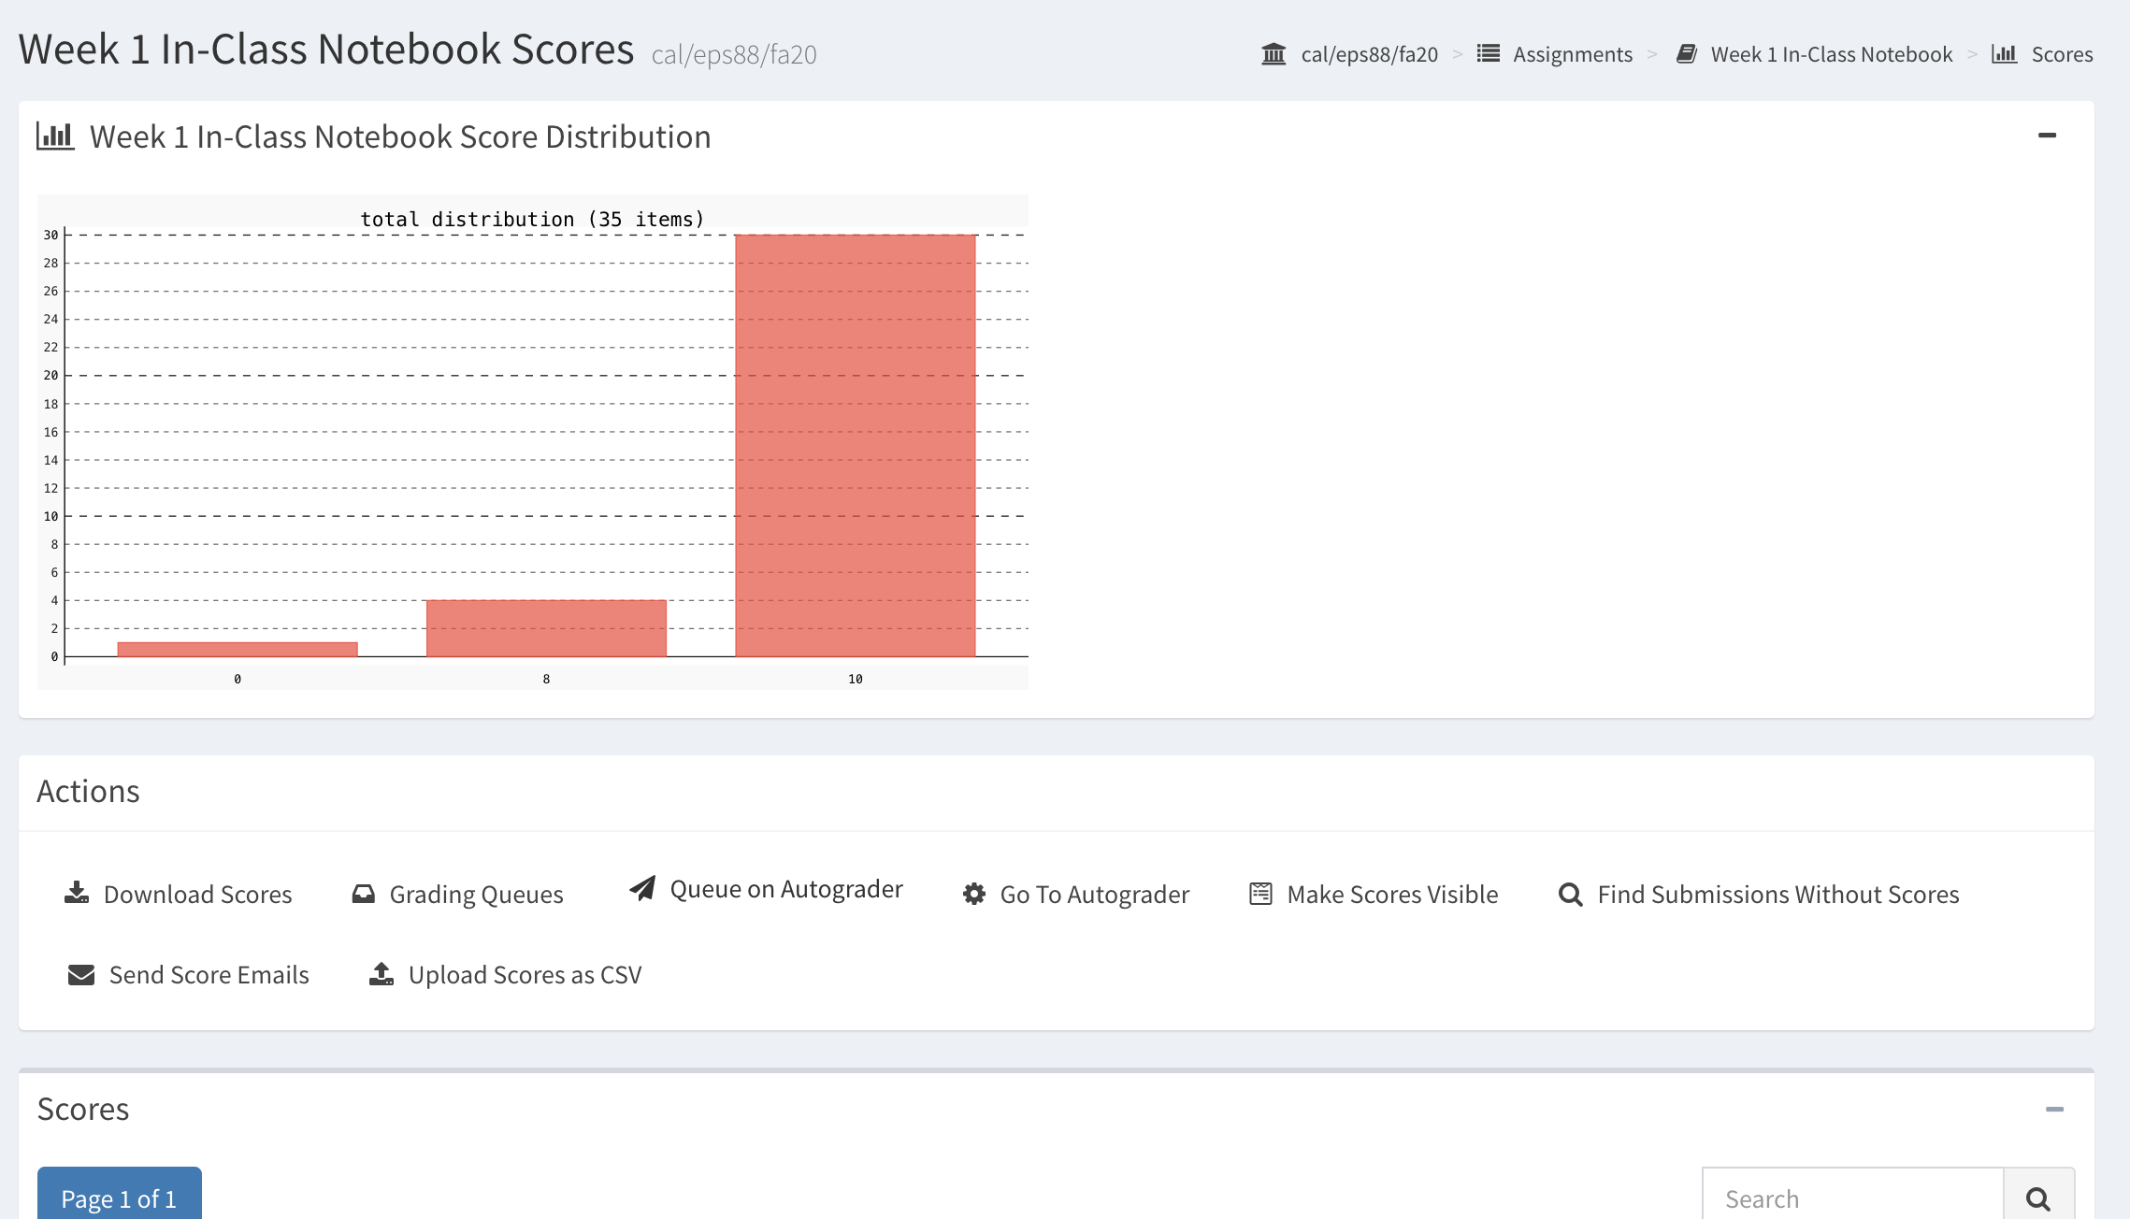

Slide 9


Slide 10
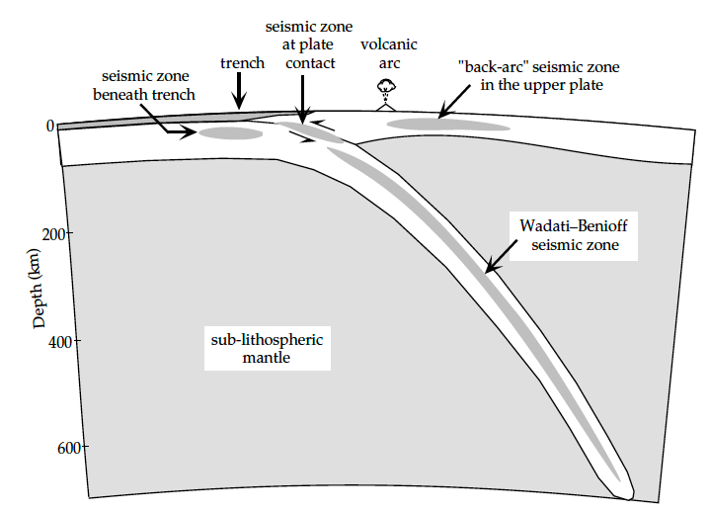
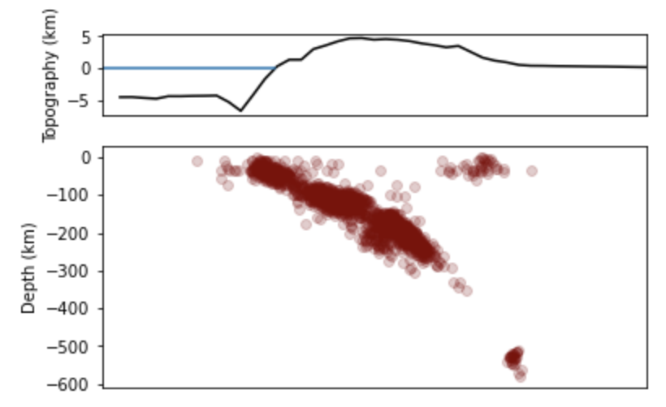
Trench
Volcanic Arc
Back-arc seismic zone in the upper plate
Seismic zone beneath trench
Seismic zone at plate contact
Wadati-Benioff seismic zone

Slide 11
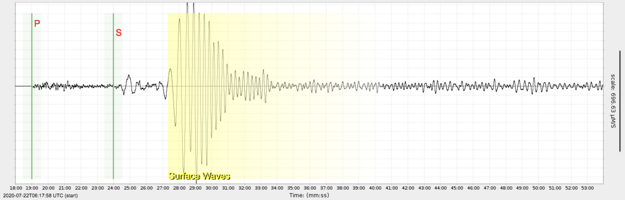
Earthquake
Seismogram
Station
P wave
S wave
Radius=6371 km
θ
angular distance

Slide 12
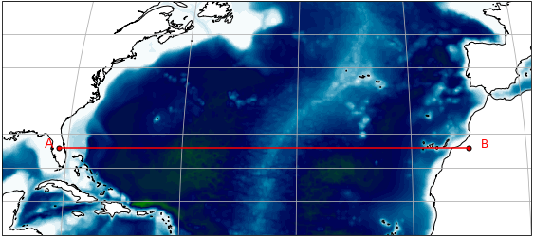
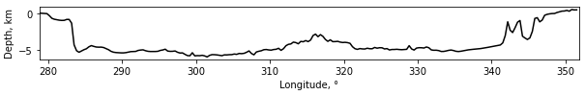
Continental margin
Deep-ocean basin
Deep-ocean basin
Mid-ocean ridge
Continental margin
A
B
1
6
2
3
4
5
Continental shelf
Continental slope
Continental rise
Seamount
Abyssal plain
Rift valley

Slide 13
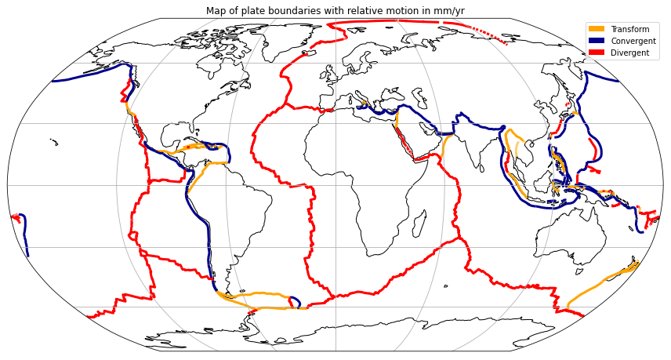
20
73
59
48
24
10
60
59
30
146
34
80
84
81
158
63
14
76
117

Slide 14
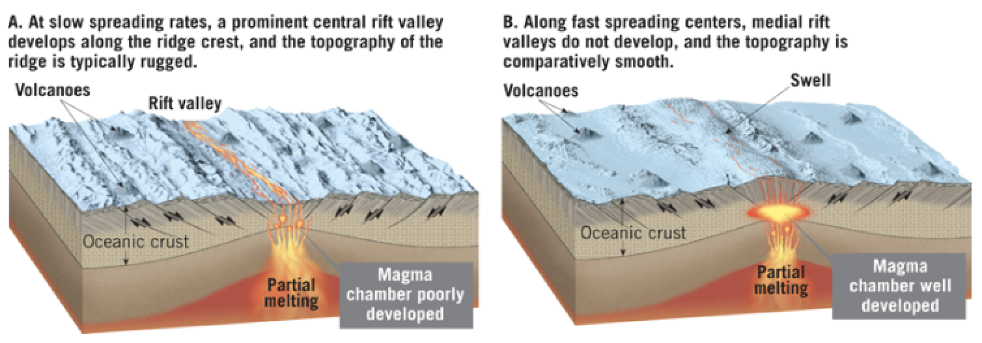
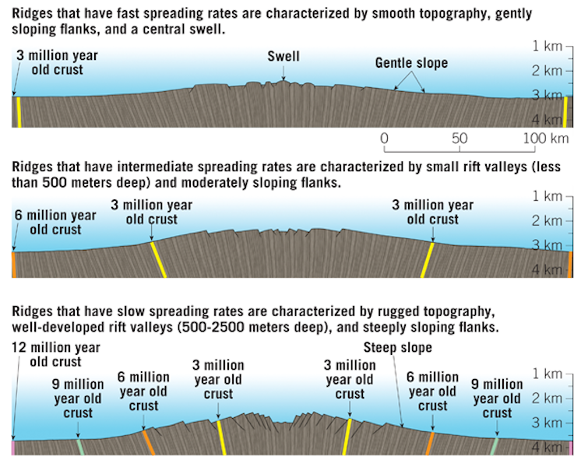

Slide 15
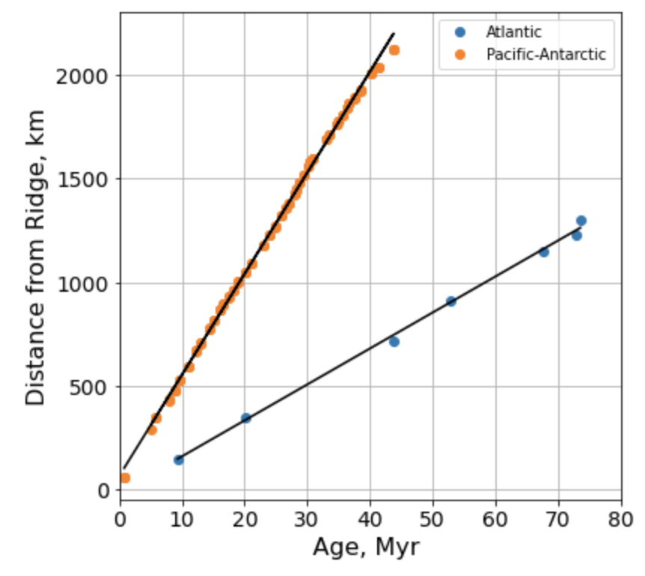
48 mm/yr
16 mm/yr

Slide 16
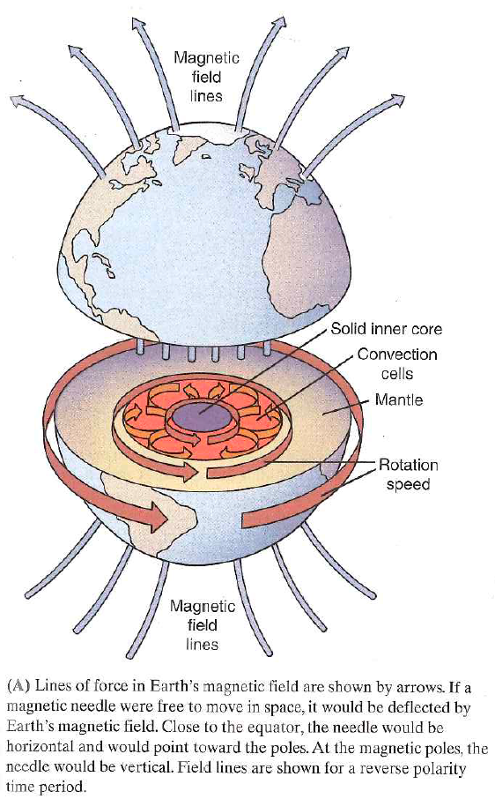
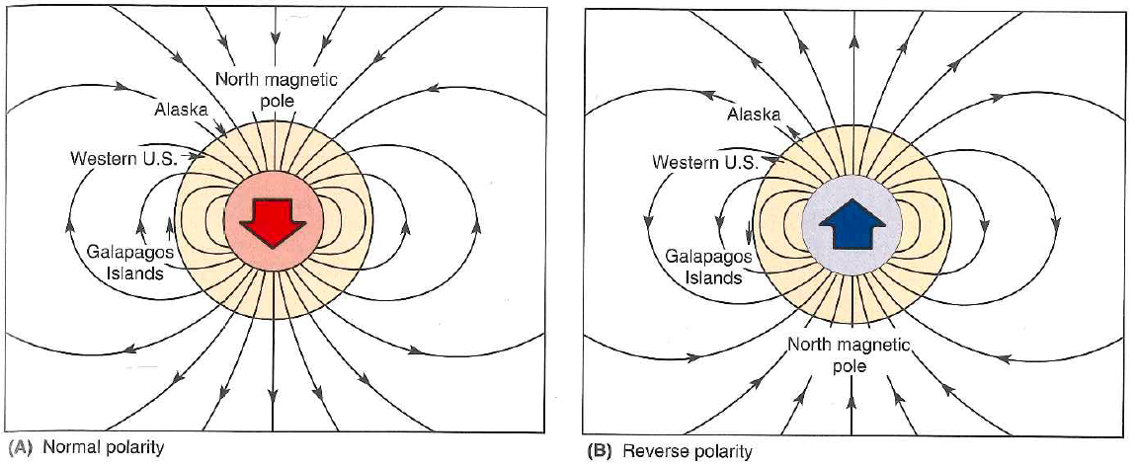

Slide 17
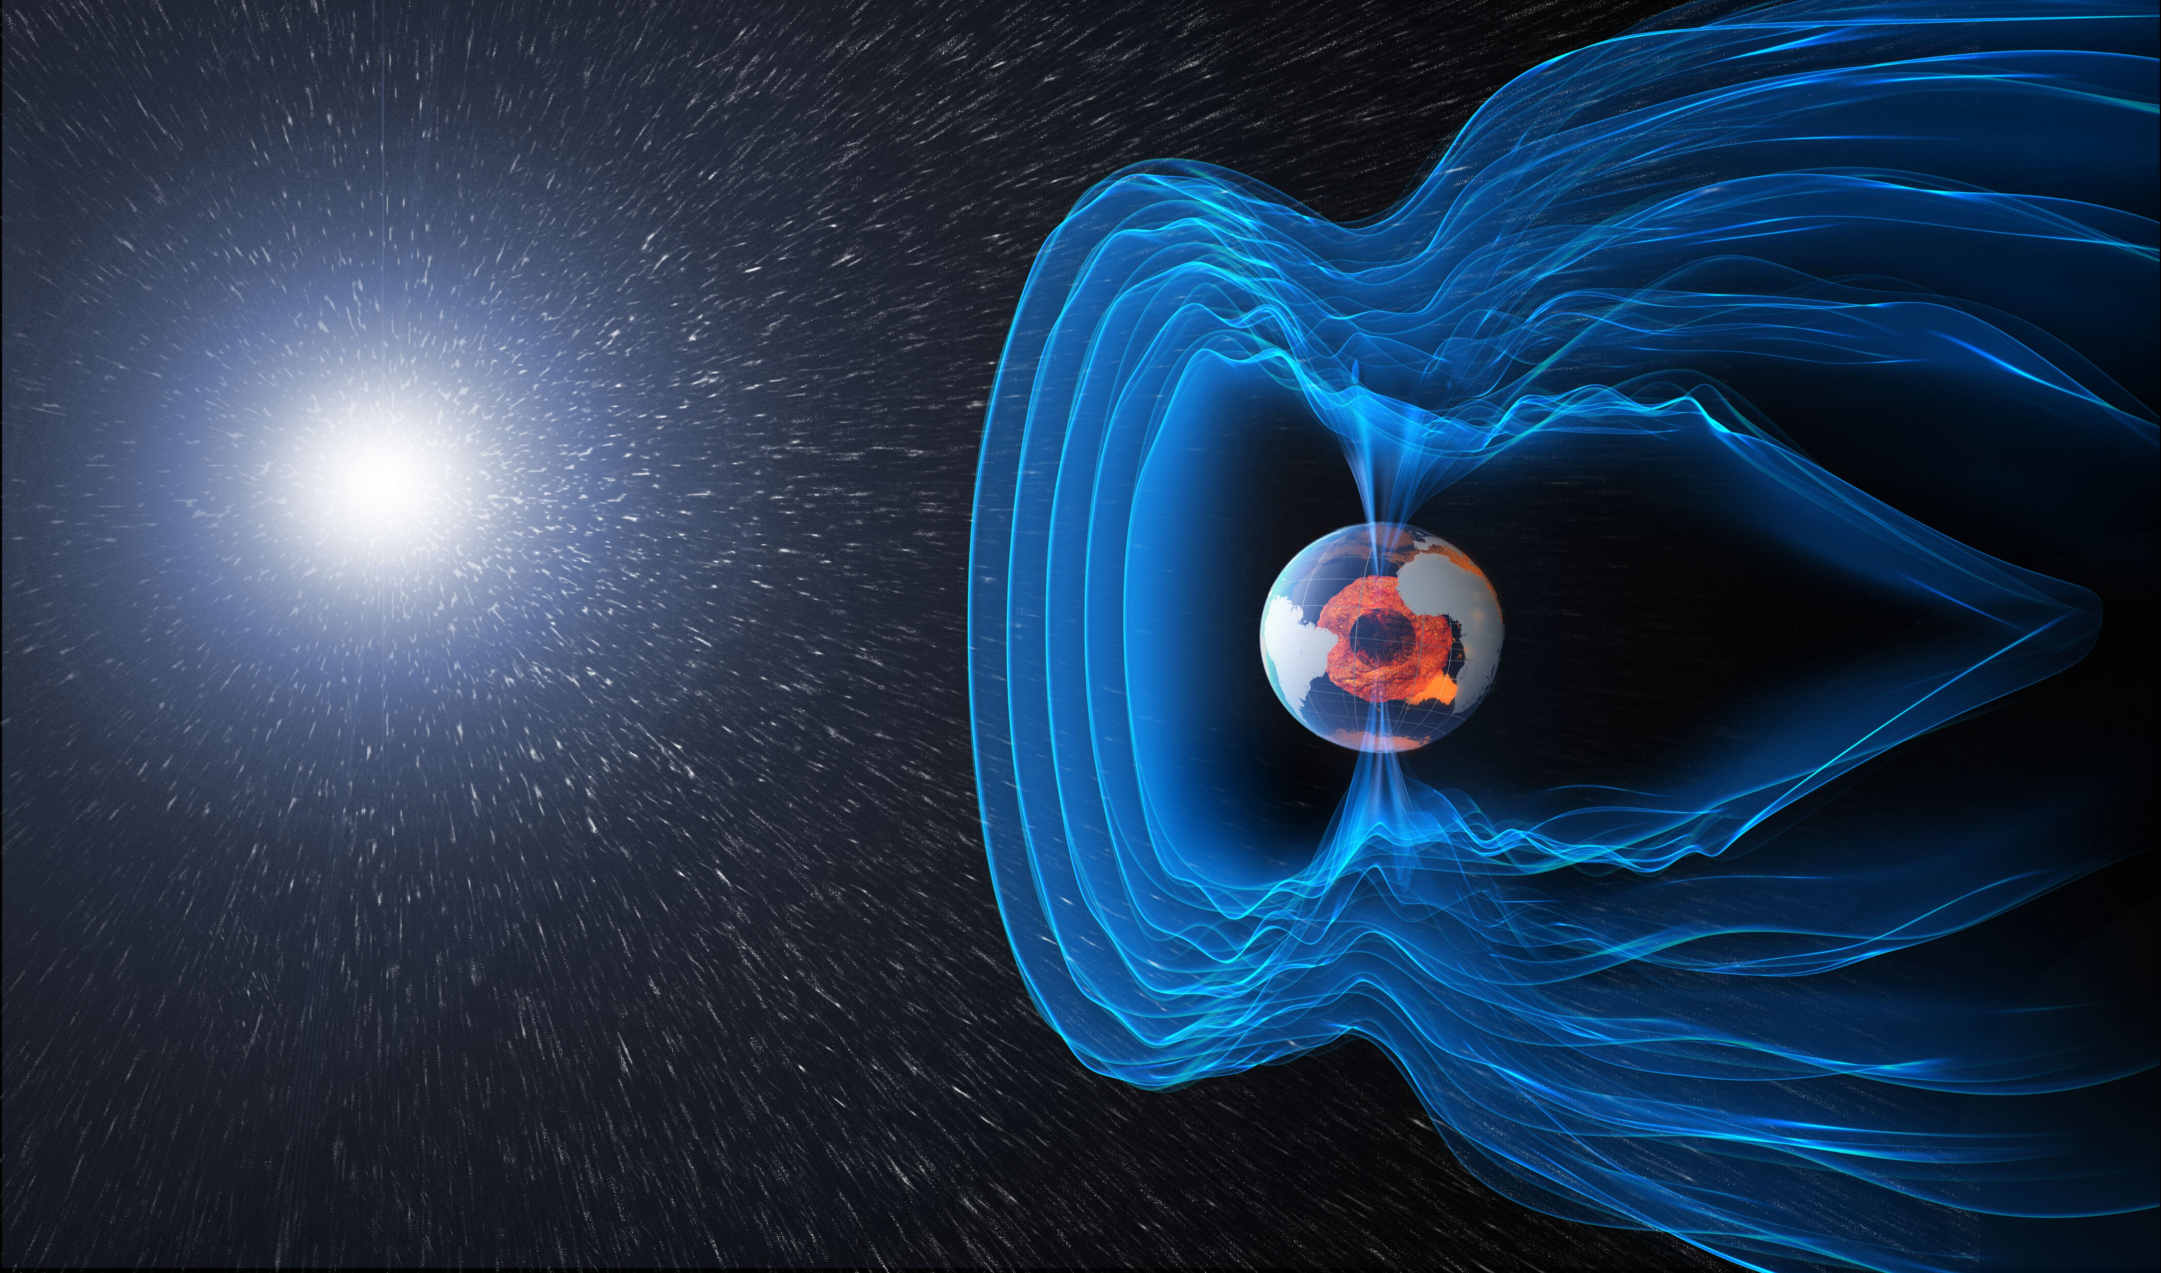

Slide 18
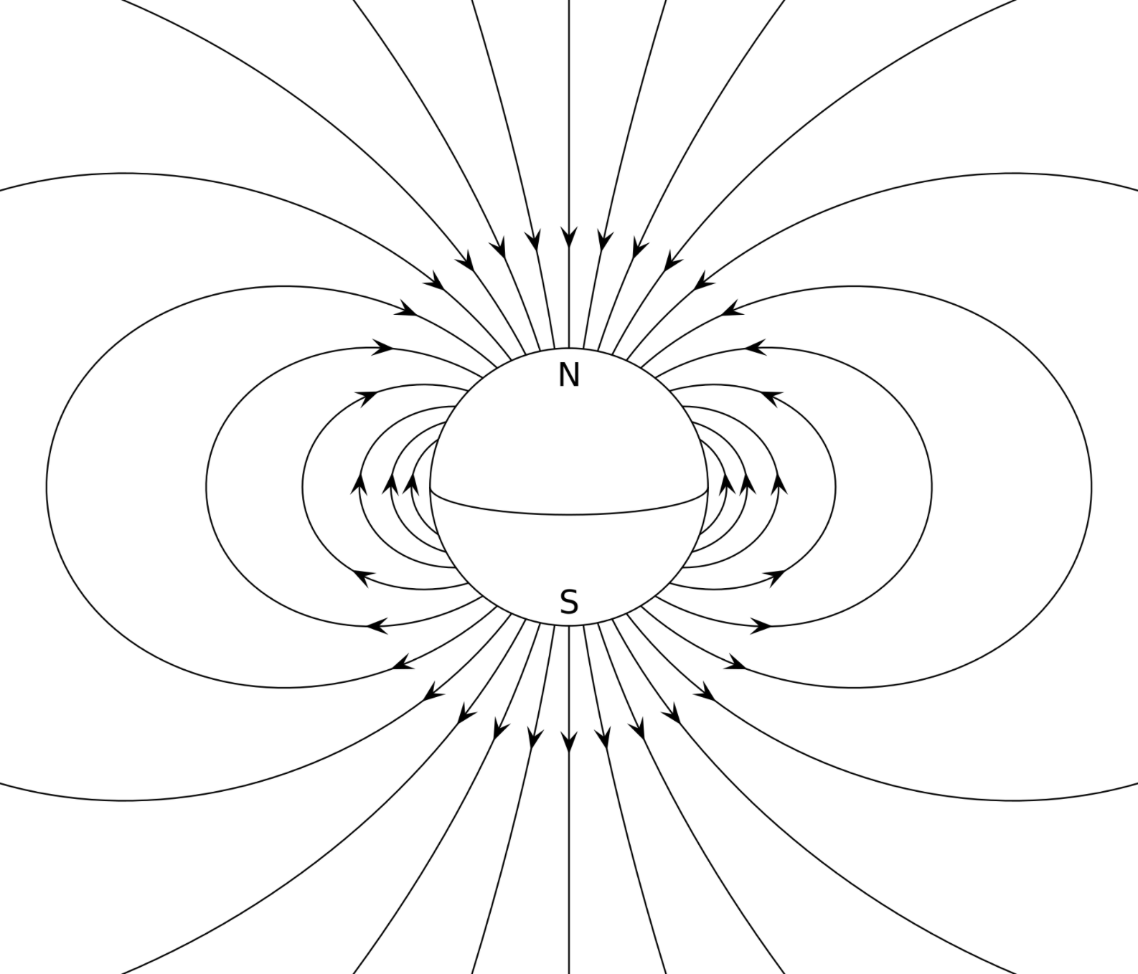
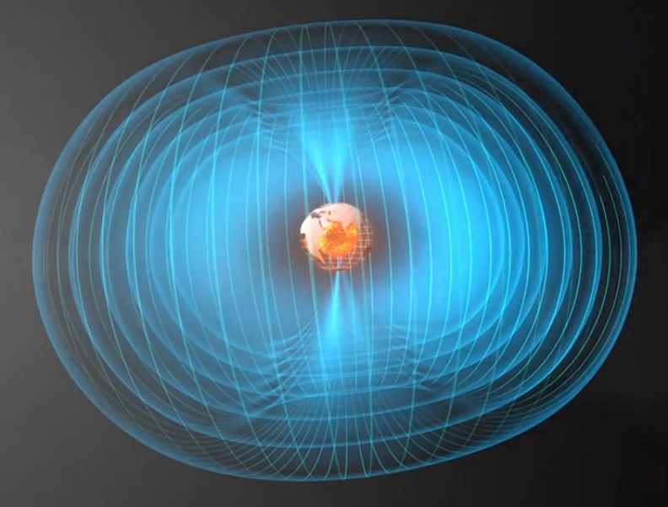
A
B
S
N
C

Slide 19
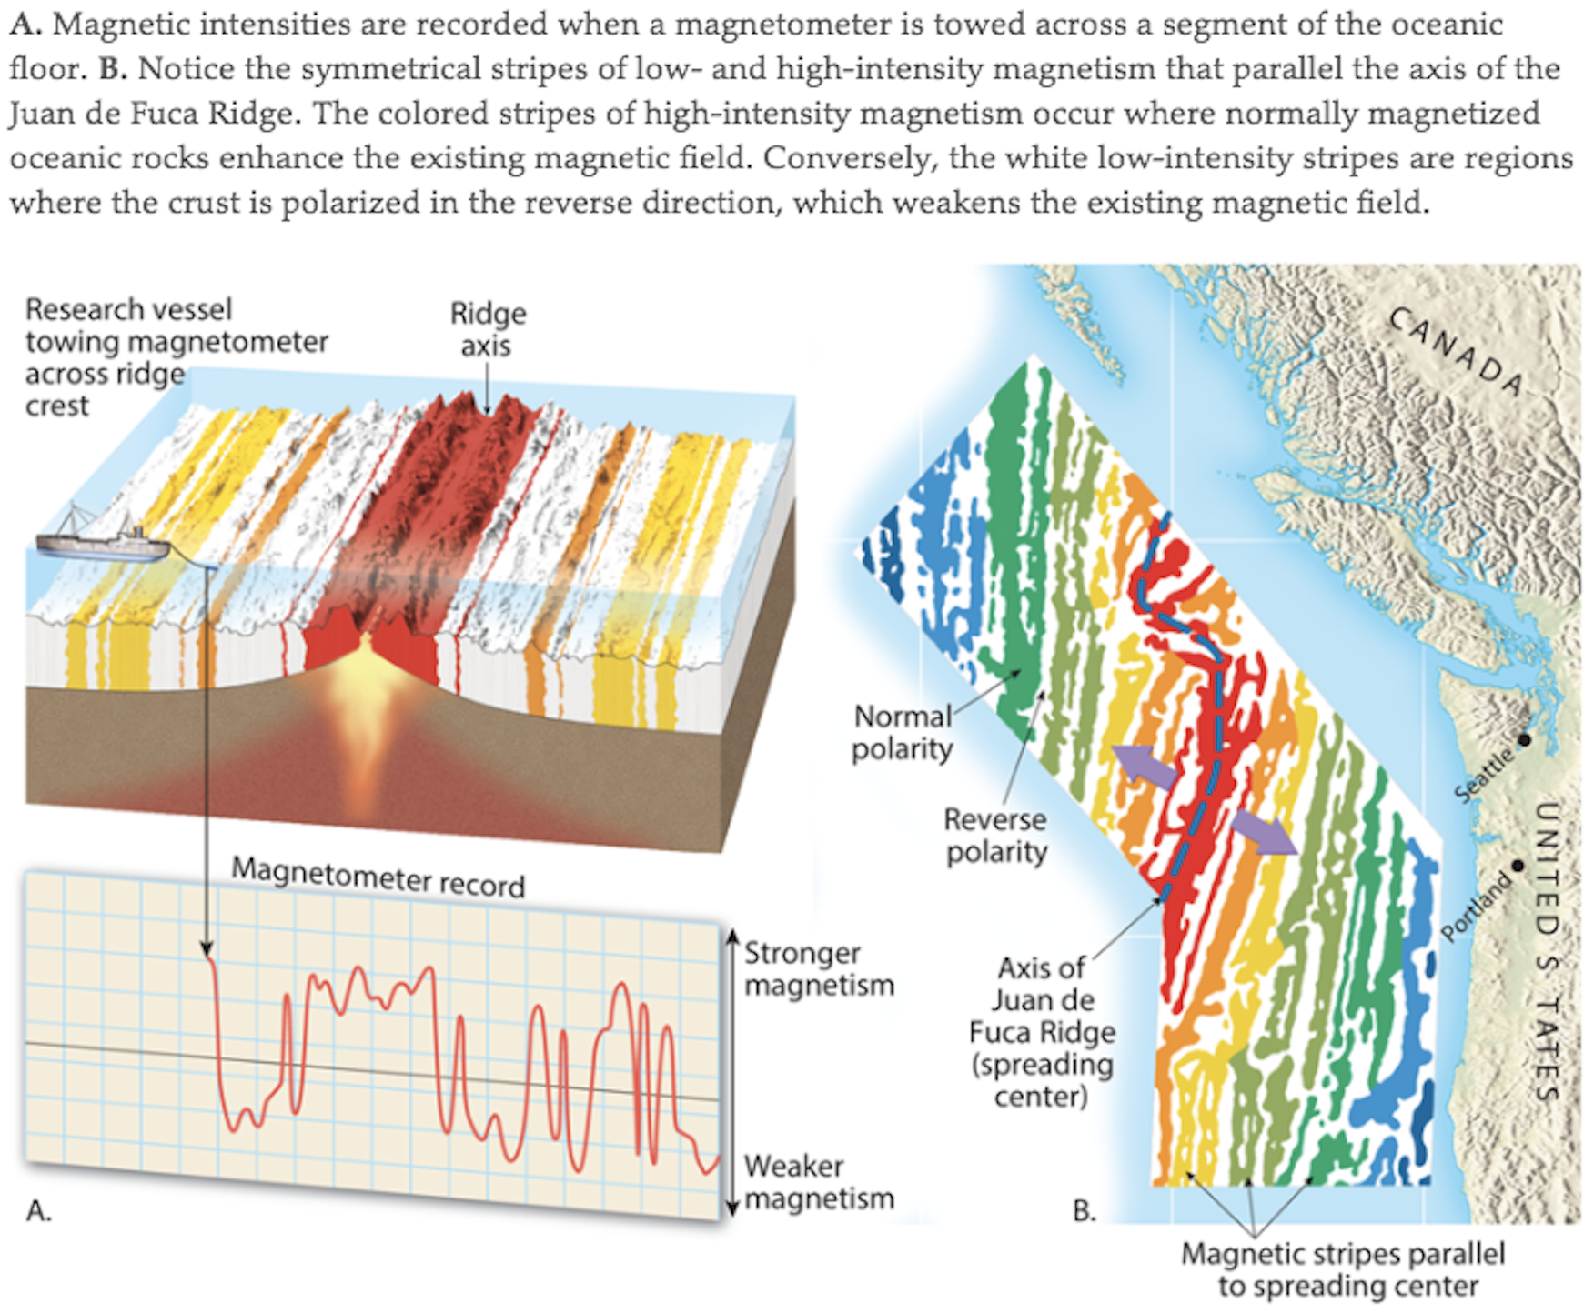

Slide 20
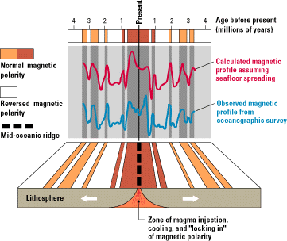
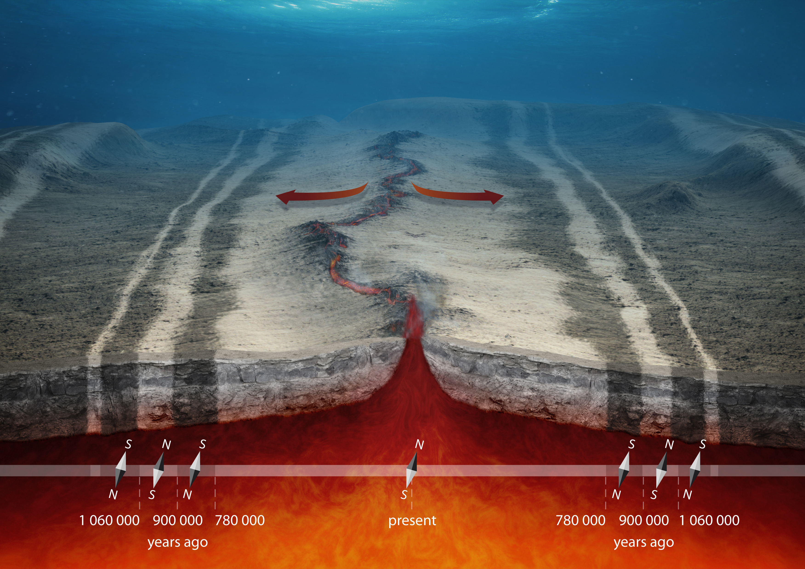
A
B

